Slide 1
Salmon Population Statistics and Trends
United States Northwest
Predictive Model
Ian Mabon

Slide 2
Takeaways
Salmon populations in the US Northwest are growing over time as opposed to declining as previously thought.
The model created can be used to anticipate the number of spawners coming into a region at a given time, meaning special preparations can be anticipated and made before the spawning season begins.
The Oregon Coast has the most significant population among the Regions in this dataset with Coho Salmon being the most abundant.
Conservationists can use this model to predict trends of salmon populations and create presentations for policymakers with the goal of protecting future salmon populations in the Northwest.

Slide 3
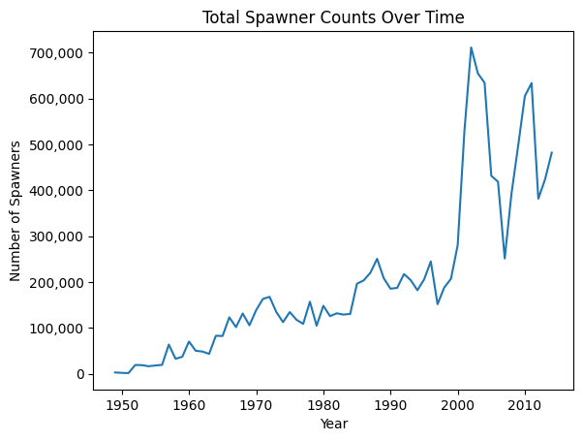
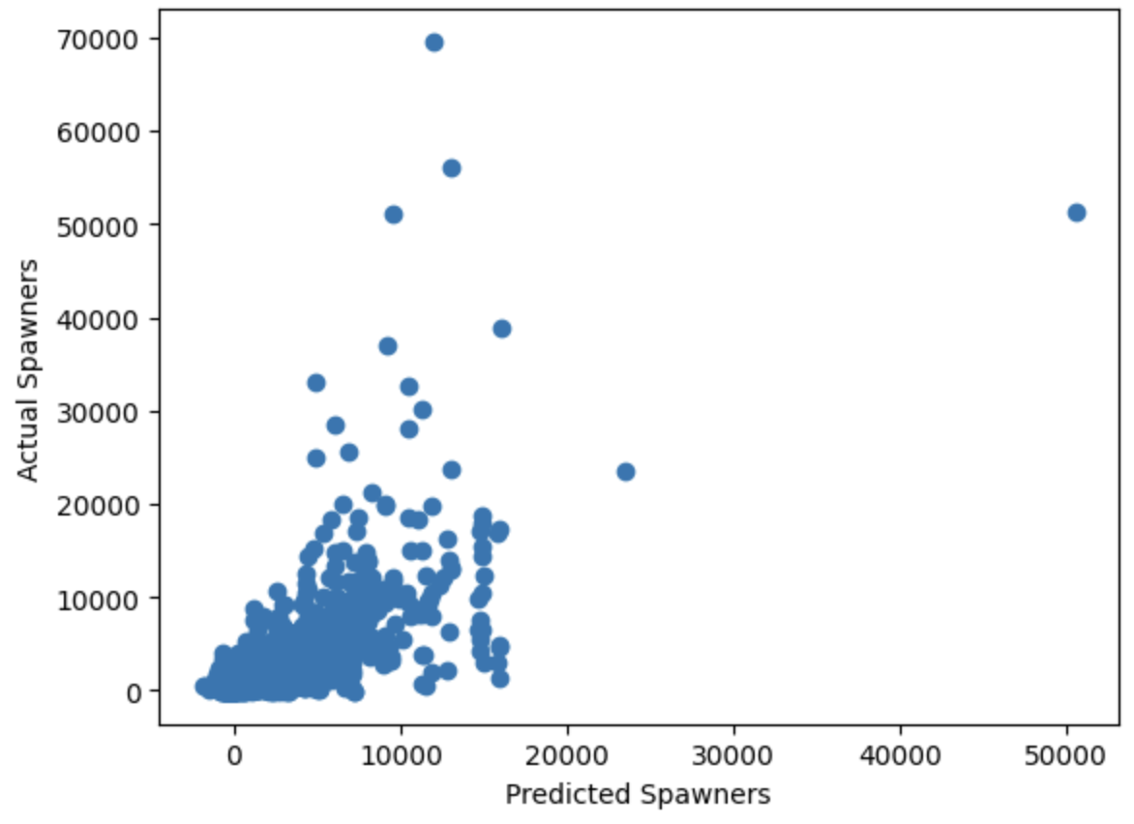
Total Salmon Population
Fluctuation in more recent measures but overall trending upward with the max population occurring in 2002 with 711,555 spawners in total.

Slide 4
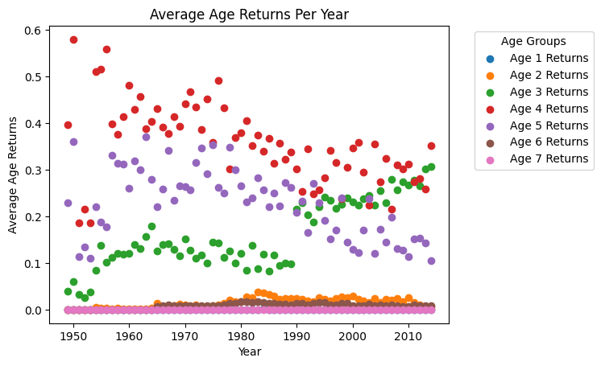
Age Returns Per Year
The highest age returns over this time series data is Age 4 with the lowest being Age 7.

Slide 5
Takeaways from the Model
Model explains approximately 50% of the data at a 30% test/train split.
R Squared Train: 0.533
R Squared Test: 0.491
RMSE = 4,734.31 meaning the model has an average root error of 4,734.31 number of spawners, but notable outliers may be skewing this estimate.
MAE = 2,676.86 means every prediction is, on average, plus or minus 2,676.86 compared to the actual number of spawners.
This model overall is decent at predicting the number of spawners but could be improved with more data (only 6,000 rows to create model).

Slide 6
Actual vs Predicted Number of Spawners
Most of the data looks like it is predicted well, but some outliers exist where the model under predicts very high actual number of spawners.

Slide 7
Thank You!

